Slide 1
OBE Implementation
Module-1:Schools
Submitted By
Team Aura 1000+ Team Members: Utsav Dave(AP23110011154), Prateek Pulkit(AP23110011175), Shruti sri Puladugu(AP23110011210), Ujjawal Pandey(AP23110011211), Abhishek Das(AP23110011180), Srinadh(AP23110011171)

Slide 2
Introduction to Project
Our University (herewith considered as SRM-AP) is going to implement OBE(Outcome Based Education) in their university and you assigned in the project to develop an application with any programming Language you are well versed and you were supposed to do searching and sorting using learned algorithms,comparing your sorting algorithm with any one of existing algorithm,displaying the time complexity of both algorithms and explaining advantages and disadvantages of the algorithm

Slide 3
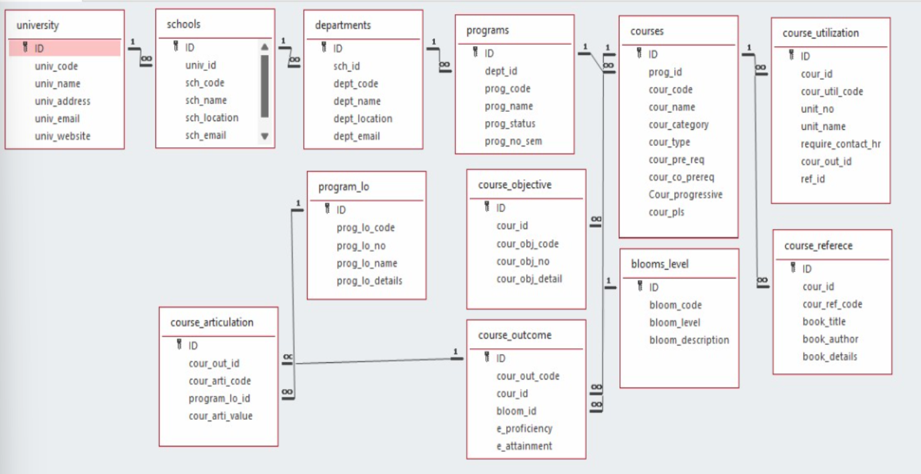
Architecture Diagram[*highlight your module as shown]

Slide 4
Module Description : School Setting
This module is used to create and manage records for the schools in SRM-AP, with super efficient implementation of the CURD operations, as thought to us in the class.
Here, to improve the efficiency and accessibility, we have stored the data feeded, in a text file, ie (aura_settings.txt) for persistence
The Data Fields, we have included here are:
ID (integer form only), School Code (String Form), Address (String form), address (String form), Email (String Form), Website (String Form)

Slide 5
School Setting:Field/table details
Field Name | Data type
id | integer
school_code | String
school_name | String
school_address | String
school_email | String
school;_website | String

Slide 6
School Setting:Programming Details
File name: Aura_schools
Function/method name
Create: Aura_schools_create
Update: Aura_schools_update
Retrieve: Aura_schools_retrieve
Delete: Aura_schools_delete
Sorting: Aura_schools_youralgorithm name
Searching: Aura_schools_youralgorithm name
Storing: Aura_schools_storing

Slide 7
School Setting:Programming Details
Comparison(both searching and Sorting):
For Searching-Search: Aura_schools_Compare_Search_algorithm
For Sorting-Aura_schoolss_Compare_Sorting_algorithm
Time Complexity(both searching and Sorting):
For Searching-Aura_schoolss_complexity_Search
For Sorting-Aura_schoolss_complexity_sorting

Slide 8
School Setting:Programming Details
Algorithm Details(pseudocode or steps)(both searching and Sorting):
For Searching-
schools_name_your_sort_algorithmname_details
For Sorting-
schools_name_your_sort_algorithmname_details
File name(for storing the details)
File name to be used is:-schools_setting .txt

Slide 9
School : Sorting Algorithm used
Sorting Algorithm Name: Bubble Sort
Algorithm:
Step-1 We would swap the adjacent elements,when compared as per need.
Step-2 Until the entire list is sorted, we would continue this process.
Time Complexity of the Bubble Sort
Worst Case: O(n^2)
Best Case: O(n) (for sorted data)

Slide 10
School : Comparison of Sorting Algorithm
Algorithm used for comparison: Quick Sort
Algorithm
Step-1 Choosing a Pivot Element
Pick an element as the "pivot" (often the first, last, or middle element) to help divide the array.
Step-2 Partition the array
Rearrange elements so those smaller than the pivot are on the left, and those larger are on the right. Place the pivot in its correct sorted position.

Slide 11
School : Time Complexity of Sorting Algorithm
Sl.No | Algorithm Name | Compared Algorithm
1 | Bubble Sort | Best O(n), AverageO(n^2), Worst (On^2)
2 | Quick Sort | Best O(nlogn), O(nlogn), Worst O(n^2)

Slide 12
School : Searching Algorithm used
Algorithm Name: Linear Search
Algorithm:
Step-1 Start from beginning of the list.
Step-2 Compare each element sequentially until the target is found.
Complexity:
Worst Case: O(n) when linearly scanning each element.

Slide 13
School : Comparison of Searching Algorithm
Algorithm used for comparison: Binary Search
Algorithm
Start with Middle Element
Find the middle element of the sorted array.
Compare with Target
If it matches the target, the search is complete.
If the target is smaller, search the left half; if larger, search the right half.
Repeat Until Found or Subarray is Empty
Repeat the process on the relevant half until the target is found or no elements remain.

Slide 14
School : Time Complexity of Searching Algorithm
Sl.No | Algorithm Name | Compared Algorithm
1. | Linear Search | O(n)
2. | Binary Search | O(log n) (requires sorted list)

Slide 15
Sample Source Code[*Depict the routine of searching,Sorting,CRUDD and Storage options]
#include <iostream>
#include <fstream>
#include <string>
#include <vector>
#define MAX 100
using namespace std;
// Schools structure
struct Schools {
int id;
string schools_code;
string schools_name;
string schools_address;
string schools_email;
string schools_website;
};

Slide 16
// Global vector to store schools data and a counter
vector<Schools> schoolss;
int schools_count = 0;
// File name for storing the details
const char* FILE_NAME = "schools_setting.txt";
// Function declarations
void Aura_schools_create();
void Aura_schools_update();
void Aura_schools_retrieve();
void Aura_schools_delete();
void Aura_schools_storing();
void Aura_schools_sortbycode();
void Aura_schools_searchbycode();
// Function to load data from the file into the schoolss vector
void load_from_file() {
ifstream file(FILE_NAME);
if (!file) {
cout << "\n🌐 [INFO] No data file found. Starting fresh.\n";
return;
}

Slide 17
for (const auto& s : schoolss) {
cout << "📌 ID: " << s.id << "\n🆔 Code: " << s.schools_code << "\n🏫 Name: " << s.schools_name << "\n📍 Address: " << s.schools_address << "\n📧 Email: " << s.schools_email << "\n🌐 Website: " << s.schools_website << "\n";
cout << "🔹-----------------------------🔹\n";
}
}
// Function to delete a schools record
void Aura_schools_delete() {
int id;
cout << "\n🗑 --- Delete School --- 🗑\n";
cout << "Enter Schools ID to delete: ";
cin >> id;
for (auto it = schoolss.begin(); it != schoolss.end(); ++it) {
if (it->id == id) {
schoolss.erase(it);
schools_count--;
Aura_schools_storing();
cout << "\n✅ [SUCCESS] School deleted successfully!\n";
return;
}

Slide 18
}
cout << "\n⚠ [ERROR] School with ID " << id << " not found.\n";
}
// Function to search schools by code
void Aura_schools_searchbycode() {
string code;
cout << "\n🔍 --- Search School by Code --- 🔍\n";
cout << "Enter Schools Code: ";
cin >> code;
for (const auto& s : schoolss) {
if (s.schools_code == code) {
cout << "\n🎓 [RESULT] School Found:\nID: " << s.id << "\nCode: " << s.schools_code << "\nName: " << s.schools_name << "\nAddress: " << s.schools_address << "\nEmail: " << s.schools_email << "\nWebsite: " << s.schools_website << "\n";
return;
}
}

Slide 19
cout << "\n⚠ [ERROR] School with code " << code << " not found.\n";
}
// Bubble sort by schools code
void Aura_schools_sortbycode() {
for (size_t i = 0; i < schoolss.size() - 1; i++) {
for (size_t j = 0; j < schoolss.size() - i - 1; j++) {
if (schoolss[j].schools_code > schoolss[j + 1].schools_code) {
swap(schoolss[j], schoolss[j + 1]);
}
}
}
cout << "\n🔄 [INFO] Schools sorted by code!\n";
Aura_schools_retrieve();
}
int main() {
load_from_file();
int choice;
while (true) {
cout << "\n🌟 --- School Management System --- 🌟\n";

Slide 20
cout << "1️⃣ Create School\n2️⃣ Update School\n3️⃣ Retrieve All Schools\n4️⃣ Delete School\n5️⃣ Search School by Code\n6️⃣ Sort Schools by Code\n7️⃣ Exit\n";
cout << "📝 Choose an option: ";
cin >> choice;
switch (choice) {
case 1:
Aura_schools_create();
break;
case 2:
Aura_schools_update();
break;
case 3:
Aura_schools_retrieve();
break;
case 4:
Aura_schools_delete();
break;
case 5:
Aura_schools_searchbycode();
break;
case 6:
Aura_schools_sortbycode();
break;

Slide 21
case 7:
cout << "\n👋 [EXIT] Thank you for using the School Management System. Goodbye!\n";
return 0;
default:
cout << "\n⚠ [ERROR] Invalid choice! Please try again.\n";
}
}
return 0;
}

Slide 22
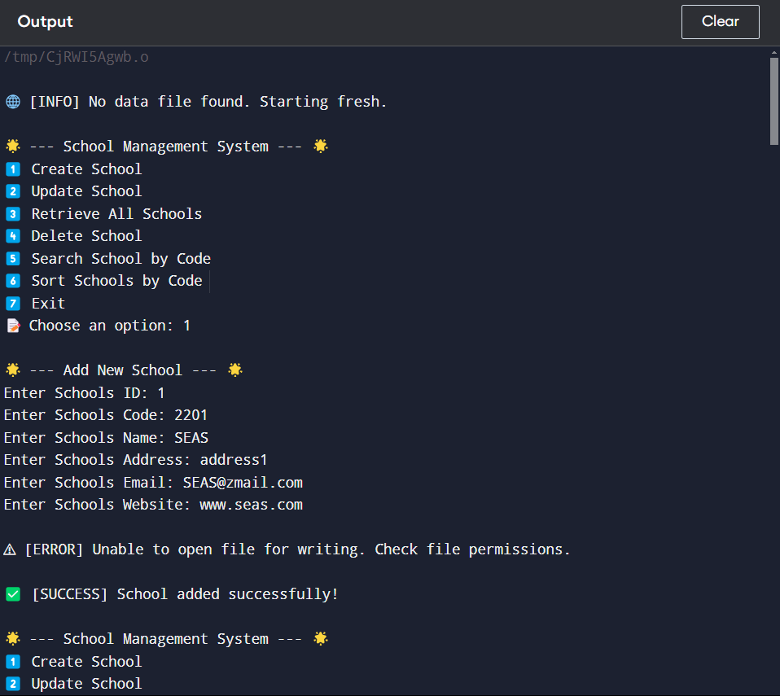
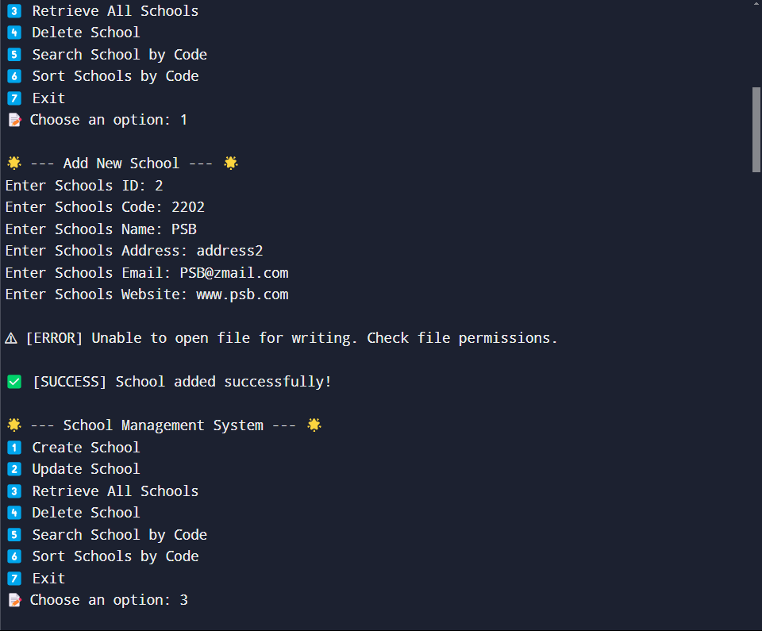
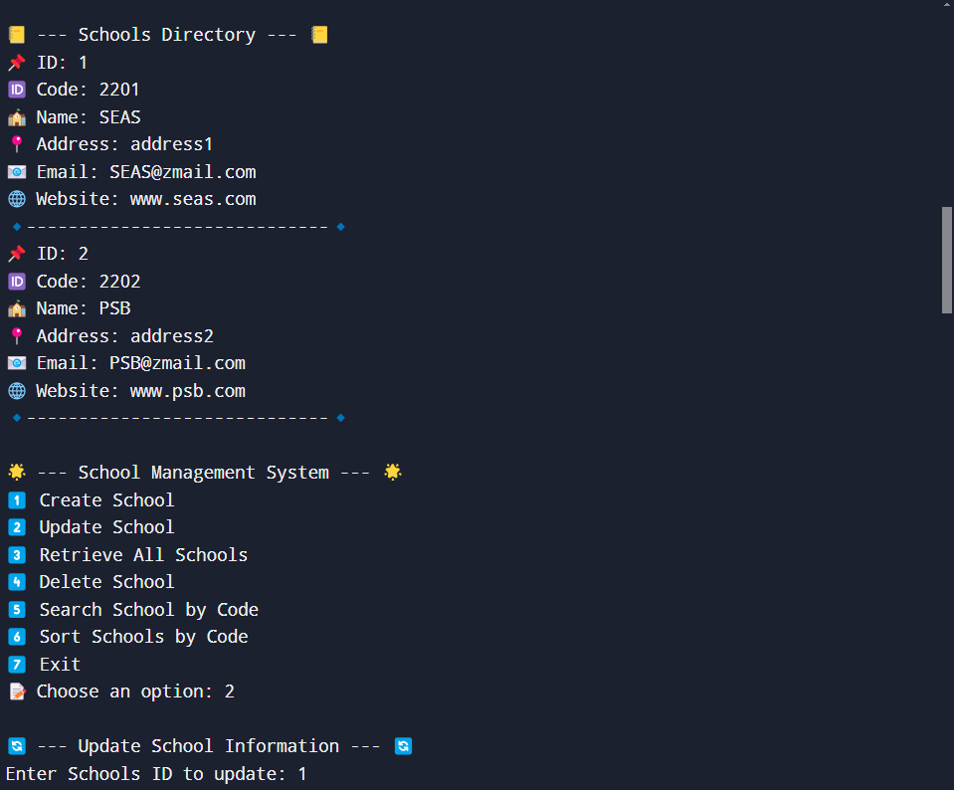
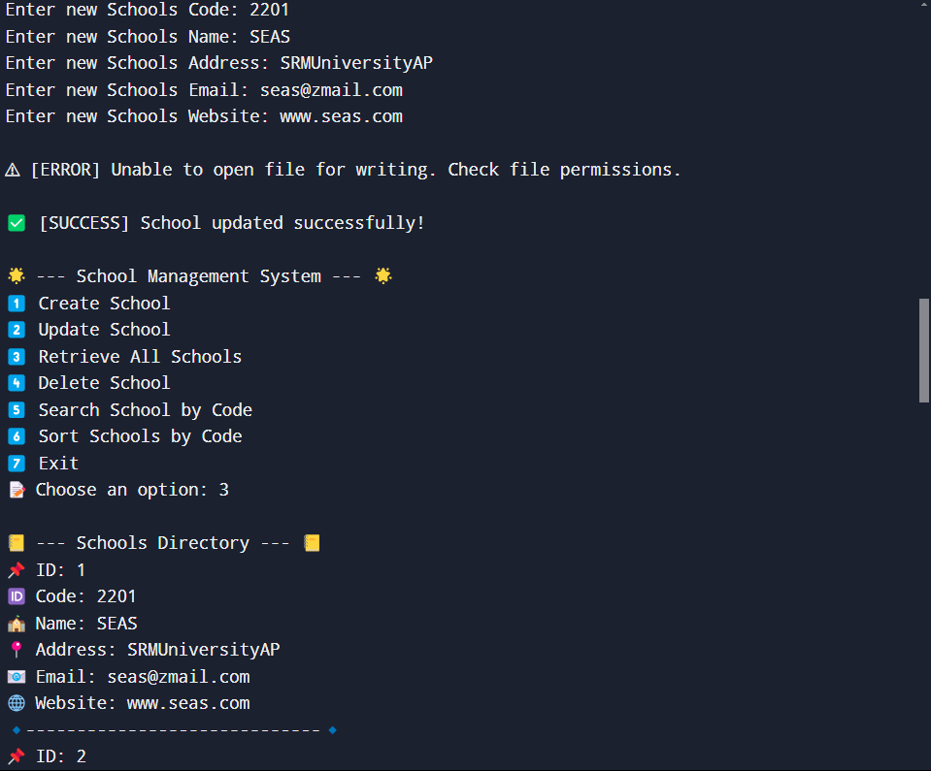
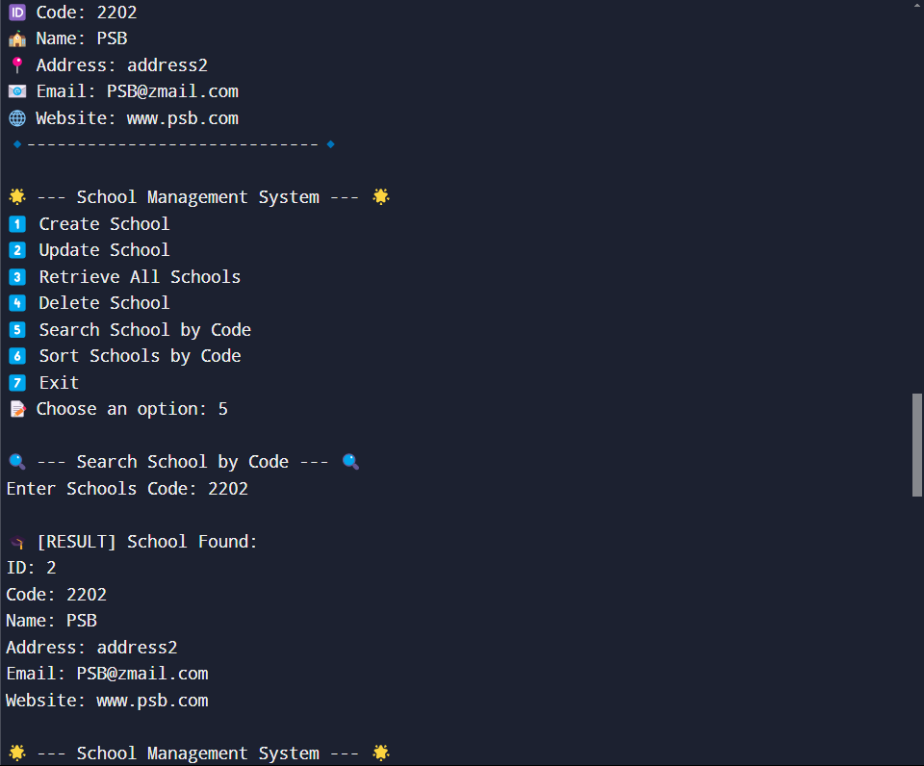
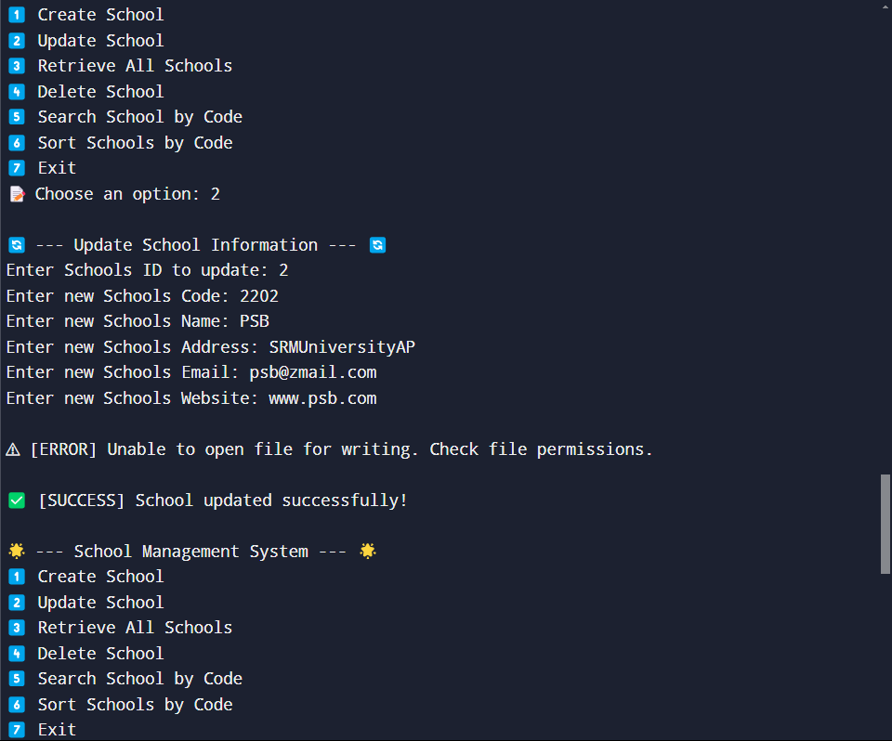
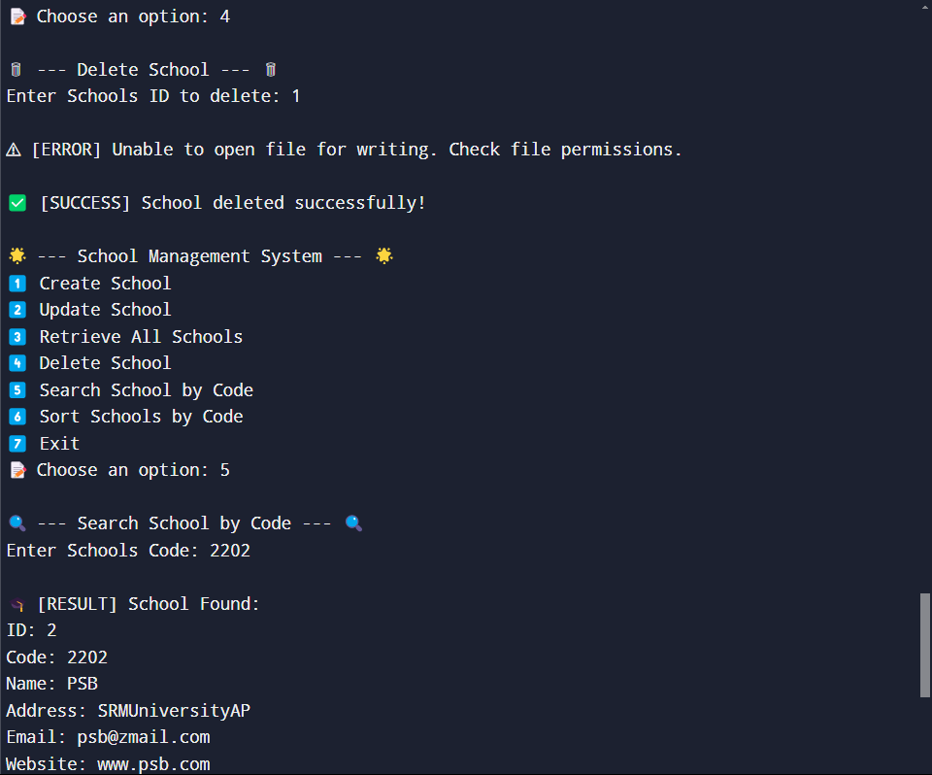
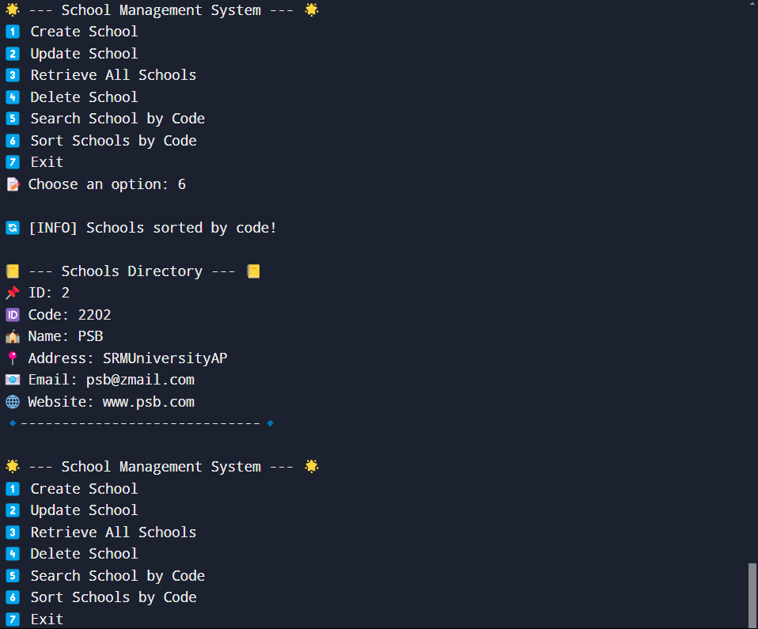
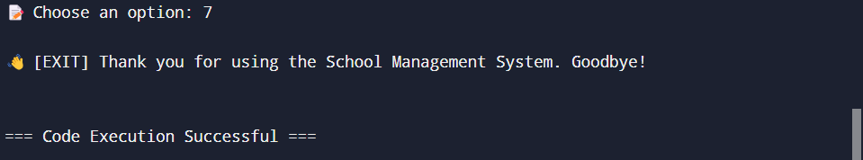
Sample Screen Shots[*Screen shot of CRUD,Sorting,Searching,Comparison(both sorting and Searching and Storage)]

Slide 23
Conclusion
In conclusion, the project successfully implements the OBE (Outcome Based Education) application with functionalities for creating, updating, retrieving, deleting, sorting, and searching schools records. The comparisons of sorting and searching algorithms demonstrate the importance of choosing the right algorithm based on the dataset size and requirements. The project adheres to the specified guidelines and provides a solid foundation for further enhancements and optimizations.

Slide 24
Thank You

